Slide 1
BreakingPoint Tcl Training
TM
Version 2.0

Slide 2
BreakingPoint Resources
BreakingPoint User Guide
Includes Tcl User Guide (171 pages)
BreakingPoint Website – http://www.breakingpoint.com
White Papers
Methodologies
Blog Posts
Webcasts
Documentation
Operating System and ATI (Strikepack) updates

Slide 3
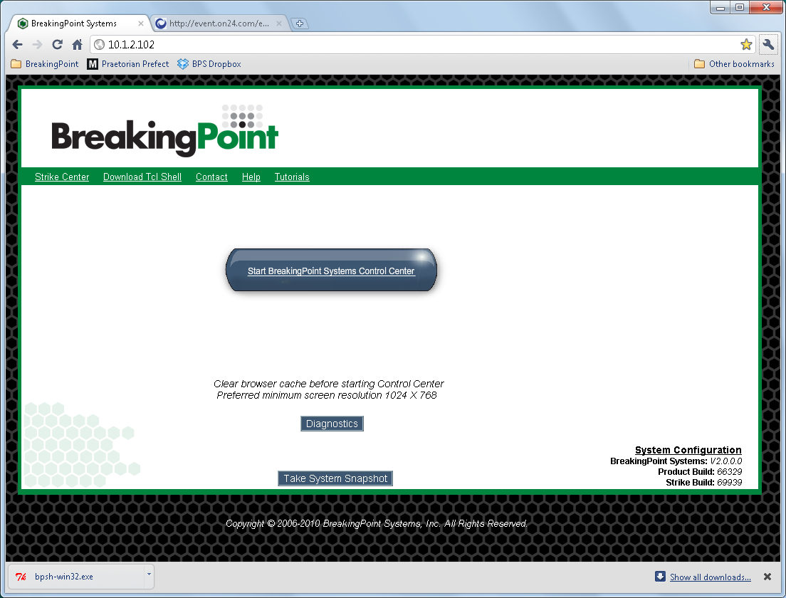
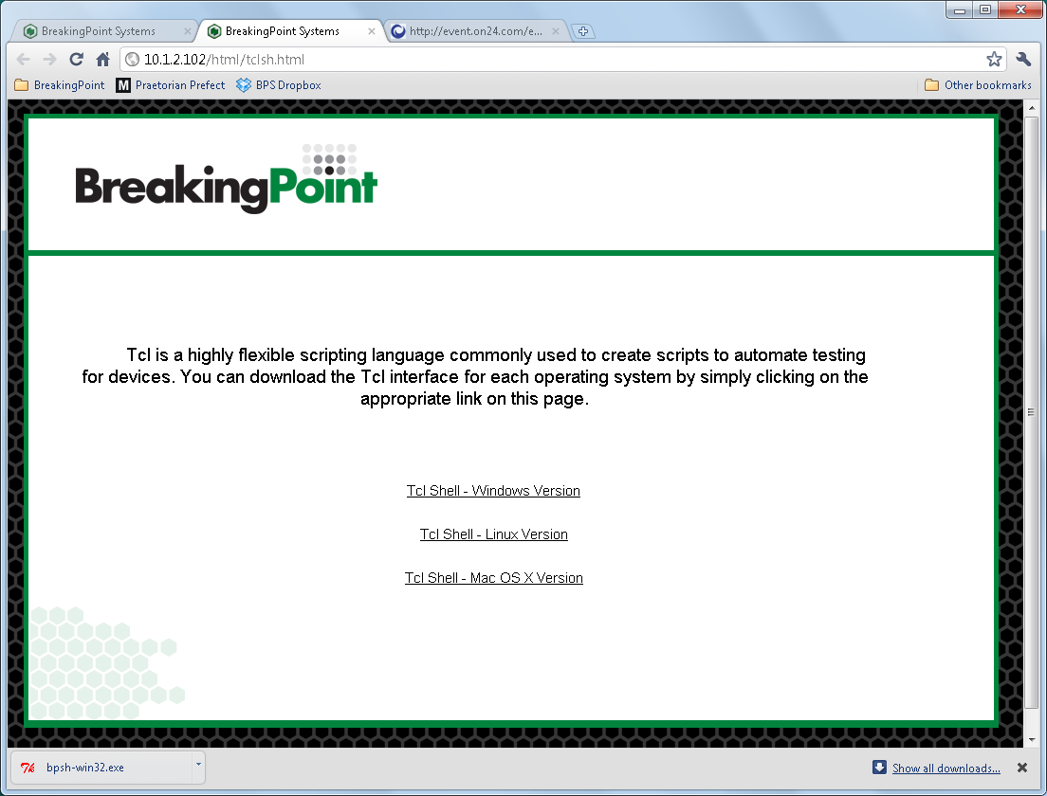
BreakingPoint Tcl Shell

Slide 4
Run a Preconfigured Test Case
Goal:
Run an existing test case using the BPS Tcl API
Export the Test Report
Export the data in the packet capture buffer to a PCAP file
BPS Test Case and Tcl Script:
STBU Strike Level 2
run_strike_test.tcl
BPS Tcl API Commands:
set bps [bps::connect $host $user $password]
set test [$bps createTest –template $bps_testcase –name $new_testcase]
$bps run –progress “bps::textprogress stdout”
set chassis_mgmt [$bps getChassis onsystemerror reportSysError]
$chassis_mgmt exportPacketTrace “C:\temp” 1 0 both
$test exportReport –file $filename –format pdf

Slide 5
Modify and Run an Application Traffic Test Case
Goal:
Load an existing test case using the BPS Tcl API
Modify and save the application profile
Assign the modified application profile and save the modified test case
Run the test case
BPS Test Case and Tcl Script:
STBU Application Profile
run _profile_bps_test.tcl
BPS Tcl API Commands:
set bps [bps::connect $host $user $password]
set test [$bps createTest –template $bps_testcase –name $new_testcase]
set app_profile [$bps createAppProfile -template $old_app_profile \
–name $modified_app_profile]
$app_profile getSuperflows
$app_profile removeSuperflow $bad_superflow
$app_profile addSuperflow $good_superflow 100
$app_profile save –name $modified_app_profile
set comp [dict get [$test getComponents] appsim_1]
$comp configure -profile $modified_app_profile
$test save
$bps run –progress “bps::textprogress stdout”

Slide 6
Modify and Run a Session Sender Test Case
Goal:
Load an existing test case using the BPS Tcl API
Modify and save the test case
Run the test case
BPS Test Case and Tcl Script:
STBU Session Sender
run_session_test.tcl
BPS Tcl API Commands:
set bps [bps::connect $host $user $password]
set test [$bps createTest –template $bps_testcase –name $new_testcase]
set comp [dict get [$test getComponents] sessionsender_1]
$comp configure -sessions.maxPerSecond $new_cps_rate
$comp configure -sessions.max $new_max_concurrent_connections
$test save -force
$bps run –progress “bps::textprogress stdout”

Slide 7
Create and Run a Custom Strike Test Case
Goal:
Load an existing test case using the BPS Tcl API
Modify and save the test case
Run the test case
BPS Test Case and Tcl Script:
STBU Custom Strike
run_custom_strike_test.tcl
BPS Tcl API Commands:
set bps [bps::connect $host $user $password]
set test [$bps createTest –template $bps_testcase –name $new_testcase]
set strikelist [$bps createStrikeList –name $strike_name]
$strikelist setStrikesFromQuery {aol OR dos OR firefox}
$strikelist save -force
set comp [dict get [$test getComponents] security_1]
$comp configure -attackPlan $new_strike_name
$comp configure –attackPlanIterations 100
$comp configure –attackProfile {}
$test save –force
$bps run –progress “bps::textprogress stdout”

Slide 8
Create and Run a RFC 2544 Test Case
Goal:
Create a RFC 2544 test case using the BPS Tcl API
Modify the test case
Run the test case
Tcl Script:
run_2544_test.tcl
BPS Tcl API Commands:
set bps [bps::connect $host $user $password]
set test [$bps createRFC2544Test]
$test configure –packetType Ether
$test configure -customSteps {64, 512, 1024, 1380, 1518}
$test run –progress “bps::textprogress stdout”

Slide 9
BreakingPoint Q & A
Mike Murphy – mmurphy@breakingpoint.com
Roy Scaife – rscaife@breakingpoint.com
BreakingPoint Webpage – http://wwwin-people.cisco.com/mikemur/
BreakingPoint Support – email: support@bpointsys.com
phone: 1-866-352-6691 extn 4
Thank you!

